Slide 1

Creating an Installer for Inventor AddIns
Philippe Leefsma
Developer Technical Services

Slide 2
Agenda
Strong-naming concept
Creating a strong-named Add-In
Creating a set-up project for an Inventor Add-In
Using InventorRegistration Utility

Slide 3
What does “strong-named” mean
Strong naming is a technology that helps uniquely identifying assemblies.
it eliminates the problem of namespace collision
many versions of an assembly can coexist and therefore applications can use the version they need
it provides a strong integrity check

Slide 4
Key features of strong-named concept
Strong names in and of themselves do not imply a level of trust like that provided by a digital signature and supporting certificate
Assemblies deployed in the global assembly cache (GAC) must have a strong name
Strong-named assemblies can only reference other strong-named assemblies

Slide 5
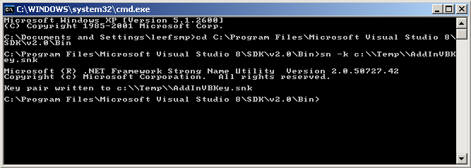
Creating a strong-named AddIn
Generate a key file: Type sn -k mykey.snk
Making the AddIn strong-named:
In the AssemblyInfo.cs file set the AssemblyKeyFile’s value:
<assembly: AssemblyKeyFile("..\\..\\..\\mykey.snk")>
Rebuild the project.

Slide 6
Creating a Strong-named Inventor interop (2008 and previous)
! The following only apply to versions earlier than 2009 !
Change to Inventor's bin directory: type cd "C:\Program Files\Autodesk\Inventor 2008\bin"
Type tlbimp rxinventor.tlb /out:c:\Temp\myversionof.interop.inventor.dll /primary /keyfile:c:\Temp\mykey.snk /namespace:Inventor
For 2009 and later, simply reference the interop located at: SDK\DeveloperTools\References

Slide 7
Using a Strong-named Add-In
Difference to be aware of: if you want to replace the existing add-in with a newer version
With an unsigned add-in you can just replace the old dll by the new one.
With a signed add-in you must re-register the add-in.

Slide 8
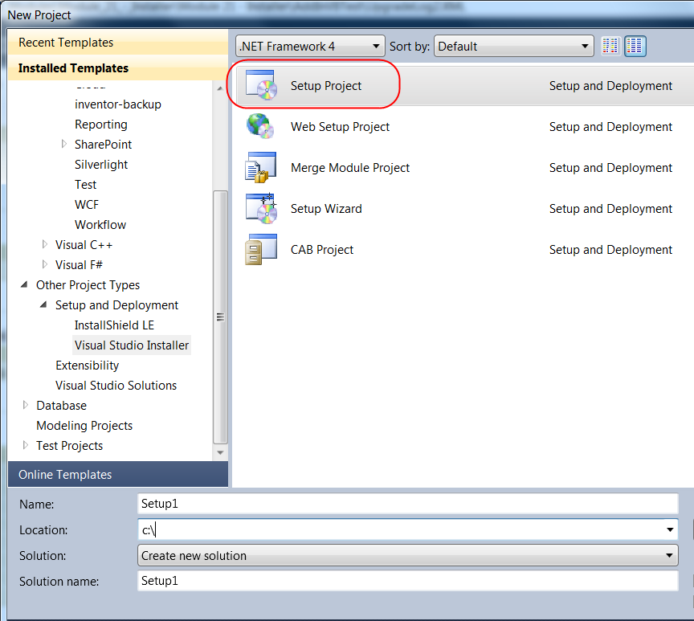
Creating a Setup project for the AddIn
Right-click on the Solution in the Solution Explorer
Select Add → New Project
In left window select Setup and Deployment Projects
In the right window select Setup Project

Slide 9
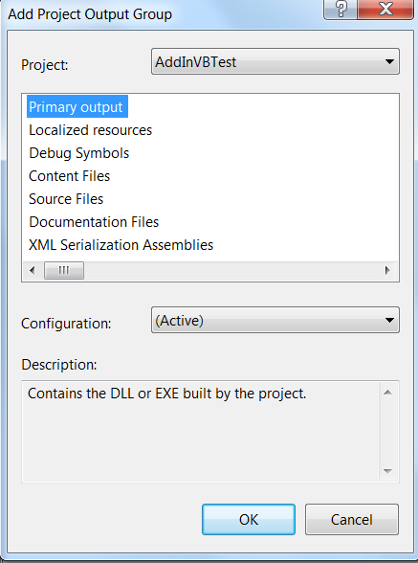
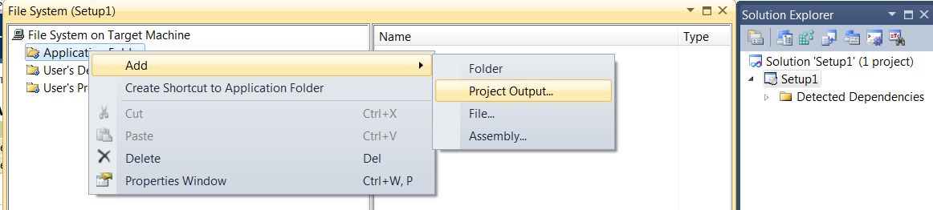
Setup Output
Right-click on AddInSetup in the Solution Explorer
Select Add → Project Output…
Select Primary Output in the appearing dialog
Click OK

Slide 10
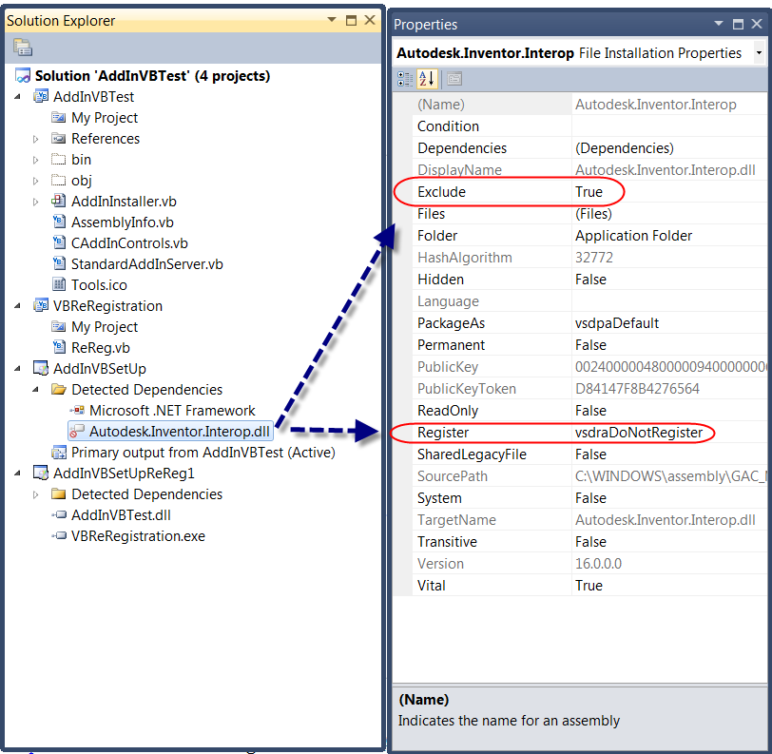
Set Dependencies Properties
Select Inventor.Interop: make sure Register property is set to vsdrfDoNotregister – otherwise the Inventor API will get unregistered if you uninstall your AddIn
Set Exclude to True

Slide 11
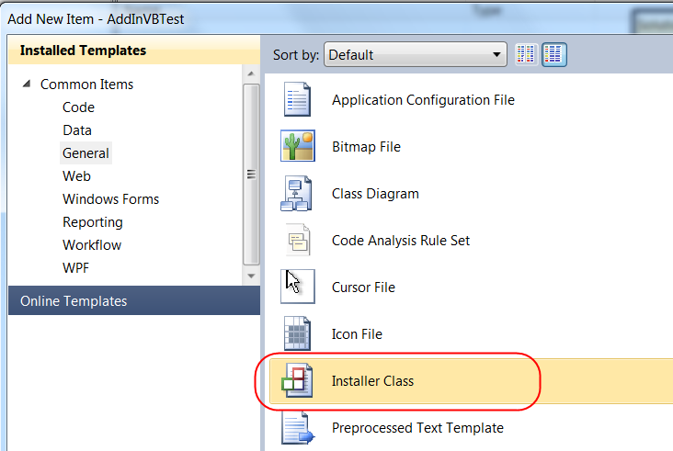
Installer Class
We need an installer class in the AddIn project that will be called by the Setup
Right-click on the AddIn project in the Solution Explorer
Select Add → Add Class…
In the right window click on Installer Class
Set the Name…
Click Open

Slide 12
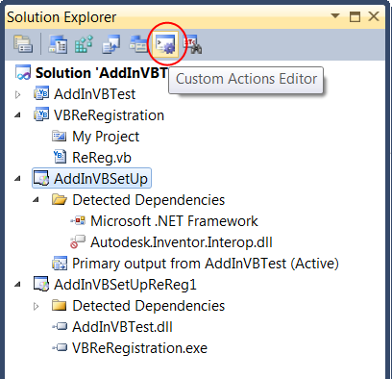
Creating Custom Actions
We need to add custom actions in the Setup project that will call the functions of our Installer class
Select AddInSetup in the Solution Explorer window
Click on the Custom Actions Editor button (in the top of the Solution Explorer window)

Slide 13
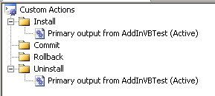
Install / Uninstall Actions
In the window that appears on the left, right-click on Install and select Add Custom Action…
Double-click on Application Folder
Double-click on Primary output from AddIn (Active)
Do the same for the Uninstall action

Slide 14
Target Platform – x86 / x64
The TargetPlatform Property of a deployment project determines whether an installer will target a 32-bit or a specific 64-bit platform.
The target platforms are x86 for 32-bit platforms, x64 for computers supporting the AMD64 and EM64T instruction sets, and Itanium for the 64-bit Itanium processor.
On 64-bit three special folders are available in the File System editor: for 64-bit applications, Common Files (64-bit), Program Files (64-bit), and System (64-bit) are the native folders; Common Files, Program Files, and System are the 32-bit equivalent folders.
Notes:
In general, 32- and 64-bit Microsoft Installer (MSI) packages are treated in the same way except for how Windows Installer treats folder variables such as [Program Files] and [System Folder], and how it writes components into the registry or GAC. When you create a 32- or 64-bit MSI package, the processor architecture is noted in the .NET Framework assembly's strong name identity when it is installed in the GAC.
Whenever you add a file or assembly to a merge module project, it is scanned to determine whether it is a 32- or 64-bit target platform. This is done in order to ensure that your 64-bit merge modules do not contain a mix of 32- and 64-bit code. If the merge module contains a 32-bit file, Visual Studio will notify you with a message and will not add the file. If you add a managed assembly marked as 32-bit only, you will get build warnings, but the file or assembly will be included in the target installation.
To distribute a .NET Framework application both to 32- and 64-bit platforms, build two MSI packages, one targeted at a 32-bit and the other a 64-bit computer. The user can install the 32-bit setup project package and it will most likely run as a 64-bit application, only the 64-bit setup project will install to the "Program Files64" directory.

Slide 15
32-bit / 64-bit MSI - Considerations
64-bit MSI packages can support both 32- and 64-bit DLLs or EXEs to perform custom actions
32-bit MSI packages cannot support 64-bit DLLs or EXEs to perform custom actions.
You can create MSI for 64-bit on a 32-bit computer.
You need to build 2 MSI in order to distribute a .Net application targeted for 32 and 64-bit platform.
To disallow installation of 32-bit MSI on 64-bit computers, add a launch condition set to "NOT VersionNT64"
Creating 64-bit MSI packages is not available in Visual Studio Express Edition.
Notes:
Some more comments:
If you target an AMD Athlon64 or Opteron computer for the MSI package, you must have MSI 3.0 or later installed.
If a setup project targeting x86 includes a file from a 64-bit folder, that file will not be included in the MSI package, even if the installation is on a 64-bit computer.

Slide 16
Deployment of Registry-Free Add-In

Slide 17
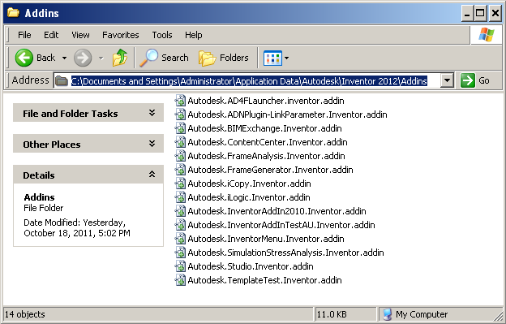
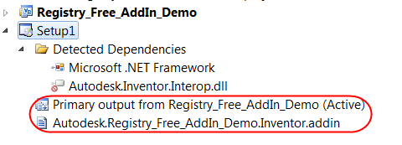
Add-in Installer – Registry Free
registry-free add-in mechanism based on “.addin” copied at specific location
on the machine.
Add-in dll can be placed anywhere on the directory structure
However how to handle this feature for the programmer since we do not know in advance where the user is going to install the add-in dll?
Notes:
Copy add-in dll file to one of following locations:
a) Anywhere, then *.addin file <Assembly> setting should be updated to the full path including the dll name
b) Inventor <InstallPath>\bin\ folder, then *.addin file <Assembly> setting should be the dll name only: <AddInName>.dll
c) Inventor <InstallPath>\bin\XX folder, then *.addin file <Assembly> setting shoule be a relative path: XX\<AddInName>.dll
Copy.addin manifest file to one of following locations:
a) Inventor Version Dependent
Windows XP:
C:\Documents and Settings\All Users\Application Data\Autodesk\Inventor 2012\Addins\
Windows7/Vista:
C:\ProgramData\Autodesk\Inventor 2012\Addins\
b) Inventor Version Independent
Windows XP:
C:\Documents and Settings\All Users\Application Data\Autodesk\Inventor Addins\
Windows7/Vista:
C:\ProgramData\Autodesk\Inventor Addins\
c) Per User Override
Windows XP:
C:\Documents and Settings\<user>\Application Data\Autodesk\Inventor 2012\Addins\
Windows7/Vista:
C:\Users\<user>\AppData\Roaming\Autodesk\Inventor 2012\Addins\

Slide 18
Add-in Installer – Registry Free
Solution: in the installer class (post-build), find where the dll is deployed and modify the element <Assembly> of *.addin
public string InstallRegistryFree(IDictionary stateSaver)
{
// Get addin dll location
Assembly Asm = Assembly.GetExecutingAssembly();
FileInfo asmFile = new FileInfo(Asm.Location);
FileInfo addinFile = null;
foreach (FileInfo fileInfo in asmFile.Directory.GetFiles())
if (fileInfo.Extension.ToLower() == ".addin")
{
addinFile = fileInfo;
break;
}
XmlDocument xmldoc = new XmlDocument();
xmldoc.Load(addinFile.FullName);
XmlNode node = xmldoc.GetElementsByTagName("Assembly")[0];
node.InnerText = asmFile.FullName;
xmldoc.Save(addinFilenameDest) ...
}

Slide 19
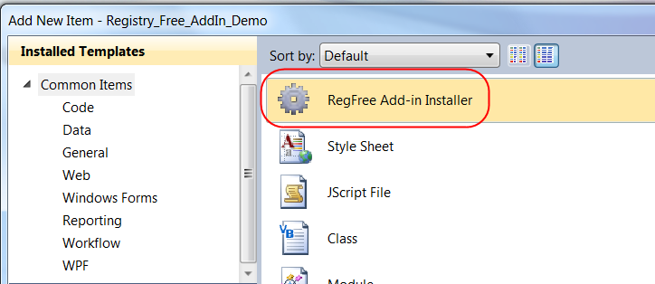
Add-in Installer – Registry Free
Registry free add-in installer class can easily be created using the custom template for C# and VB.Net in the material provided in this class.
To installing the custom templates Copy RegFree Installer Template C#.zip and RegFree Installer Template VB.Net.zip to the following location:
Windows XP:
C:\ Documents and Settings \<user>\My Documents\Visual Studio <version>\Templates\ItemTemplates
Windows Vista/7:
C:\Users\<user>\My Documents\Visual Studio <version>\Templates\ItemTemplates

Slide 20
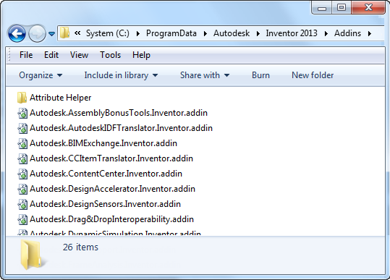
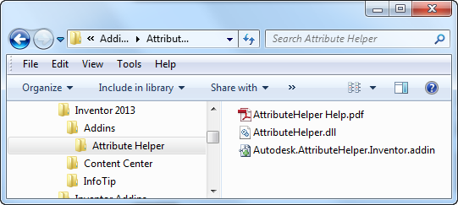
Add-in Installer – Registry Free
From 2013, path of dll can be relative to .addin location
At Inventor start-up subdirectories will be searched for .addin files
Recommended: Add-in dll + resouces + .addin file placed in a folder
App of Exchange Store:
Installer will copy folder to %APPDATA%\Autodesk\ApplicationPlugins
Notes:
It’s now possible to have all of the files an add-in requires to be in a single directory and when copied into one of the valid add-in locations will enable your add-in. Subdirectories beneath the add-in location directories will be searched for .addin files. So a folder dropped into an add-in location can contain subfolders and can contain multiple .addin files that can specify to load different dll’s based on OS type and version.

Slide 21
Deployment of Registry Add-In

Slide 22
Installer Methods override
Imports System.Runtime.InteropServices
Public Overrides Sub Install (ByVal stateSaver As System.Collections.IDictionary)
MyBase.Install(stateSaver)
Dim regsrv As RegistrationServices = New RegistrationServices()
regsrv.RegisterAssembly(Me.GetType().Assembly, AssemblyRegistrationFlags.SetCodeBase)
End Sub
Public Overrides Sub Uninstall (ByVal savedState As System.Collections.IDictionary)
MyBase.Uninstall(savedState)
Dim regsrv As RegistrationServices = New RegistrationServices()
regsrv.UnregisterAssembly(Me.GetType().Assembly)
End Sub

Slide 23
Using InventorRegistration Utility
Problematic:
For example, user has installed Inventor 2009 and Inventor 2010 and the corresponding versions of the AddIns: AddIn2009 and AddIn2010, which have the same GUID for the CLSID.
Uninstalling AddIn2009 will also uninstall AddIn2010.
Solution:
If you want to preserve the AddIn's CLSID across multiple AddIn versions, then you need to implement a re-registration executable.

Slide 24
Implementing IAddInRegistrationInfo
imports InventorRegistration ‘Ref. to InventorRegUtils.dll
Class CReReg : Implements IAddInRegistrationInfo
Dim m_guidStr As String = "{9C28ED35-8E07-40e6-AD2C-3B2C3BD9FA04}"
Dim m_descriptiveName As String = "RegisterAddInVB2009"
Dim m_executablePath As String = Assembly.GetExecutingAssembly().Location
Dim m_supportedVersions() As VersionSupportRule = New VersionSupportRule() _
{ _
New VersionSupportRule(VersionSupportType.SupportedSoftwareVersionGreaterThan, "11..") _
}
Dim m_dotNetAssemblies() As String = New String() _
{ _
"AddInVBTest.dll" _
}

Slide 25
Implementing IAddInRegistrationInfo
Public Sub Register() Implements InventorRegistration.IAddInRegistrationInfo.Register
Utils.RegisterDotNetAssemblies(Path.GetDirectoryName(ExecutablePath), m_dotNetAssemblies, True, True)
End Sub
Public Sub Unregister() Implements InventorRegistration.IAddInRegistrationInfo.Unregister
Utils.RegisterDotNetAssemblies(Path.GetDirectoryName(ExecutablePath), m_dotNetAssemblies, False, True)
End Sub

Slide 26
Implementing IAddInRegistrationInfo
Public Module ReReg
Public Sub Main(ByVal args As String())
InventorRegistration.Utils.DoAddInRegistration(args, New CReReg())
End Sub
End Module

Slide 27
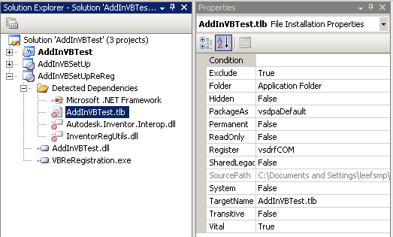
Creating Re-Register Installer

Slide 28
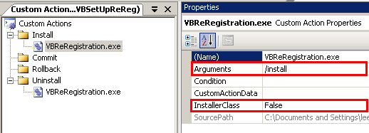
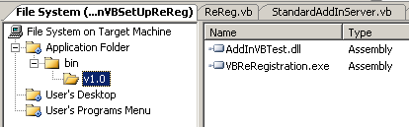
Re-Register Installer - Settings
Invoke re-registration executable with "/install" argument during install.
Respectively "/uninstall" during the uninstall.
Define the file structure of the install folder

Slide 29
Re-registration - Considerations
This re-registration executable will have to create a new GUID for each version of the executable that is Generated. Typically, for each version of the AddIn.
The re-registration executable can specify that .NET assemblies as well as standard dll's need to be registered. If needed, you can also add registry settings directly.

Slide 30
Setup Project Sample
A full sample is available in the SDK:
SDK\DeveloperTools\Samples\VCSharp.NET\AddIns\
SimpleAddIn
\Registration
\Installer
Notes:
You can take advantage of the InventorRegUtils.dll, which is part of the installation and you can get a reference to it after installing the SDK Developer Tools.
There is a sample project for this in the samples folder, which can also be used as a template and reused inside your project.

Slide 31

You are ready to build your installer!

Slide 32

Notes:
Thank you!
Questions?

